Slide 1
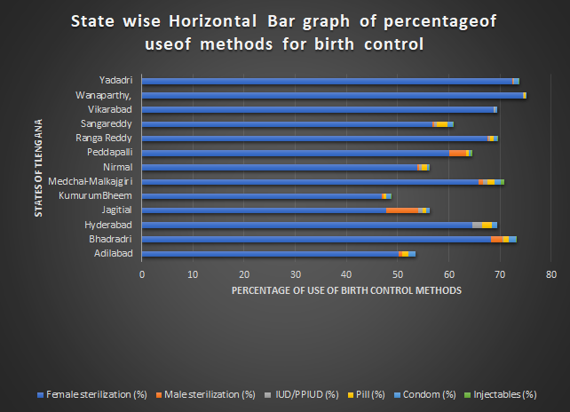
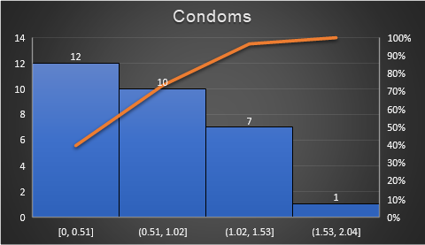
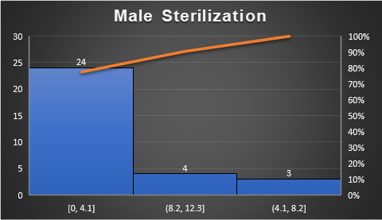
The above graph also indicates that other 5 methods are used in a very low proportion.
Screen reader support enabled.
SDG 3 GOOD HEALTH AND WELL BEING : ANALYSIS ON FAMILY PLANNING METHODS USED BY PEOPLE OF TELENGANA
Completed by : Gururaj Awale , Rahul Mourya, Purnima Agarwal , Neha Mumbaikar
Introduction
Results
India was the first country in the world to have launched a National Programme for Family Planning in 1952. With its historic initiation in 1952, the Family Planning Programme has transformed in terms of policy and actual program implementation. There occurred a gradual shift from the clinical approach to the reproductive child health approach and further, the National Population Policy (NPP) in 2000 brought a holistic and a target-free approach which helped in the reduction of fertility. Over the years, the program has been expanded to reach every nook and corner of the country and has penetrated the Primary Health Centers and Sub Centers in rural areas, Urban Family Welfare Centers, and Post-partum Centers in the urban areas.An unmet need for contraception points to the gap between women’s reproductive wish to avoid pregnancy and their contraceptive behavior. Different people want different things from a contraceptive method. Some want a method that guarantees there is no chance of pregnancy. Some want a quick return to fertility so they can get pregnant soon after stopping a contraceptive method. Some do not want to think about contraceptives every time they have sex. Some do not want to depend on their partner for the success of the method. Some women do not want to remember to take a daily pill, while others find that is easy. And there are still other factors that influence method choice. Some may need protection from STIs and will choose condoms to be used alone or in addition to another contraceptive method. Some people want a method they can always get easily whenever they need more while some prefer fertility awareness methods because of religious beliefs, because they are worried about side effects, or do not like other methods. Some women want a method that their partner will not know they are using. A few may have a medical condition that could affect the safe use of a particular method. For many people, the effectiveness of a family planning method is important. The chart below compares the effectiveness of methods as commonly used along with their safety issues.
Methodology
Fig 3 shows that around 70% of telengana districts use condom. method in a very low proportion( less than 1%). Maximum use of condom method by any district is only 2.04% which is very low
Concept : Strategies to accelerate progress of India's family planning are discussed and the importance of improving the quality and reach of services by providing method choice is emphasized.Various method exist and have been practice in Telangana, India for family planning. We will study and understand the current use of family planning
Methods 1) Female sterilization : the fallopian tubes are permanently blocked or removed. This prevents the fertilization of eggs by sperm
2)Male sterilization: the male vasa deferentia are cut and tied or sealed so as to prevent sperm from entering into the urethra
3) Pill "the pill", is a type of birth control that is designed to be taken orally by women. It includes a combination of an estrogen and a progestogen
4) Condom Condoms help protect against pregnancy and sexually transmissible infections
5) IUD/PPIUD
IUDs primarily work by preventing fertilization. The progestogen released from hormonal IUDs mainly works by thickening the cervical mucus, preventing sperm from reaching the fallopian tubes.
Postpartum Intrauterine Contraceptive Device
PPIUD can be inserted immediately postpartum, after either vaginal or caesarean delivery. Insertion after vaginal delivery can be post placental (within 10 mins of delivery of the placenta) or within 48 hours.
6) Injectable is a form of birth control. It is an injection, or shot, that contains progestin. This is a natural hormone that your ovaries produce each month as part of your menstrual cycle.
In the given data we will briefly introduced category from the current use of family planning to the quality of family planning, further we will discuss the indicators , different method use for family planning in Telangana [refer Sr no 20 – 31]
The need to do so is greater now than ever before because couples in India want to both limit family size and space their births. There is, therefore, an urgent need to provide a choice of contraceptive methods to enable couples to achieve their reproductive goals. However, female sterilisation, a terminal method, has for decades, remained the mainstay of the national programme. In 2005-2006,
The method-mix includes five official methods[Indian J Med Res. 2014 Nov; 140(Suppl 1): S137–S146.] female sterilisation, male sterilisation, intrauterine contraceptive device (IUCD), oral contraceptives, and condoms. Between 1998-19992 and 2005-20061, there was a minimal increase (from 6.8 to 10.1%) in the proportion of couples using oral contraceptives, IUCDs, and condoms. Procedure for male sterilisation and condoms have been seriously promoted for the prevention of HIV and other sexually transmitted infections, men's engagement in family planning has remained minimal1,3
There is ample evidence to show that adequate birth spacing has positive effects on the health of both the mother and the infant4
Fig 1 shows statewise bar graph of percentage of use of various methods for birth control . The above graph clearly indicates that around 45% to 75% population uses female sterilization for birth control. The above graph also indicates that other 5 methods are used in a very low proportion.
Conclusion
From the given visualizations performed in Fig 1,2,3. Fig 1 shows that around 45% to 75% population uses female sterilization for birth control, it also indicates that the other 5 methods are used in a very low proportion. This implies that most of the precautions for birth control are taken by women. So we decided to check separately the methods used by the male population that is:Male sterilizationcondomfig 2(male sterilization) gives us the idea that around 80% of Telangana districts use the male sterilization method in a very low proportion which is less than 4%. fig 3(condom) shows that around 70% of Telangana districts use condom method in a very low proportion (less than1%). This shows that a very less proportion of males take precautions for birth control. This difference could be due to less awareness among the population of Telangana about birth control measures taken by men. Suggestion: Hence we suggest that certain steps should be taken by the Telangana government to increase awareness about birth control measures used by men as male sterilization and condom methods are considered safer than female sterilization by doctors. Doctors say that the use of female sterilization leads to certain hormonal changes which are considered dangerous to both mother and infant.
Refernces
12 I. India, Mumbai: IIPS; 2007. International Institute for Population Sciences (IIPS) and Macro International. National Family Health Survey (NFHS-3), 2005-06. [Google Scholar]
15. Pachauri S. Expanding contraceptive choice in India: Issues and evidence. J Fam Welfare. 2004;50:13–25. [Google Scholar]
21. Conde-Agudelo A, Anyeli Rosas-Bermúdez, Ana Cecilia Kafury-Goeta. Birth spacing and the risk of adverse perinatal outcomes: A meta-analysis. JAMA. 2006;295:1809–23. [PubMed] [Google Scholar]
Fig 2 shows that around 80% of telengana districts use male sterilization. method in a very low proportion( less than 4%). Maximum use of male sterilization method by any district is only 12.3% which is very low.

